Slide 1

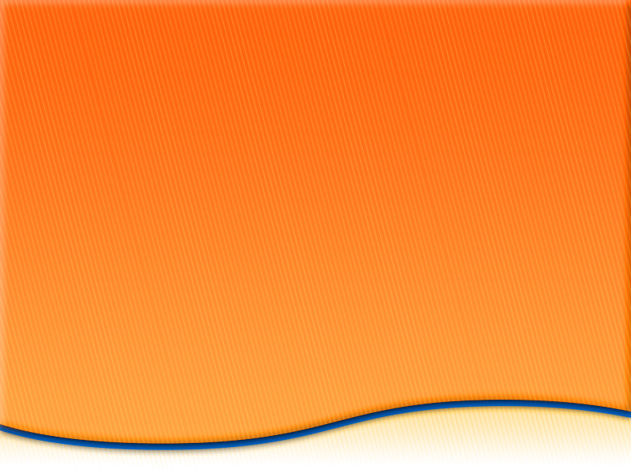

Unit 5
Selling
  Chapter 12 Preparing for
  the Sale
  Chapter 13 Initiating the Sale
  Chapter 14 Presenting the Product
  Chapter 15 Closing the Sale

Slide 2
What Is Selling?
Chapter 12
Preparing for the Sale
  Section 12.1 What Is Selling?
  Section 12.2 Getting Ready To Sell

Slide 3
What Is Selling?
  Objectives
  Define Personal selling
  Explain the purpose and goals of selling
  What is Feature Benefit Selling
  Rational and emotional buying motives
  List three levels of customer decision making
Marketing Essentials Chapter 12, Section 12.1

Slide 4
What Motivates Us to Buy
Customer buy merchandise and service to satisfy and ?
Need you must have to survive? Give a few examples:

Slide 5
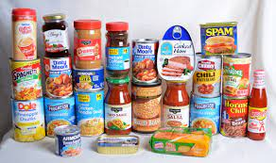
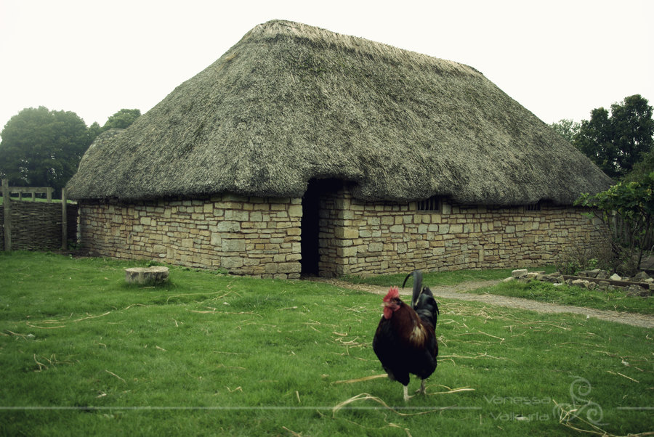

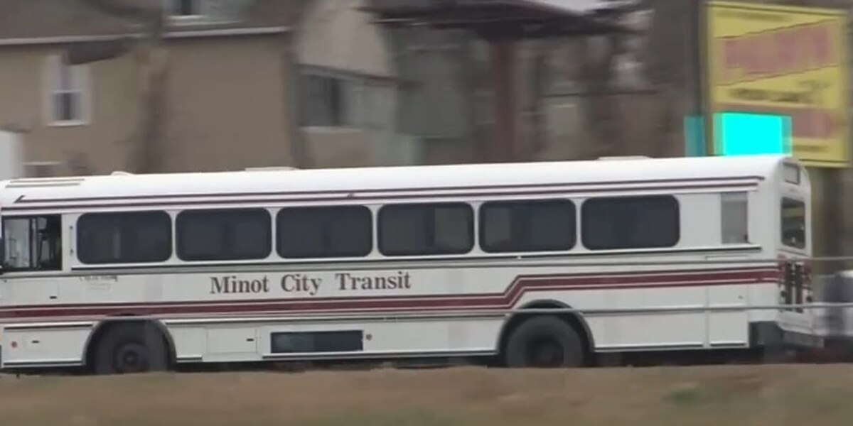
BASIC NEEDS: Food, Clothing, Shelter
Food
Shelter
Clothing
Transportation

Slide 6
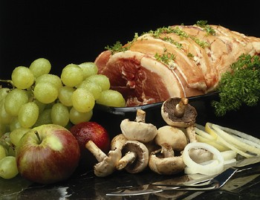
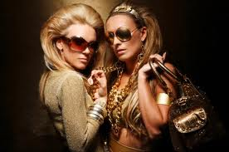


Wants and MORE Wants
Food
Clothing
Shelter
Transportation

Slide 7

Groups of Four
Divide into Groups of 4
Older Open the Google Form: Group Activity Buying Motives
Answer Questions 1 & 2 do not move on.

Slide 8
What Motivates Us to Buy
What did we buy and why

Slide 9
Groups of Four
Answer Questions 3

Slide 10
What Motivates Us to Buy
What are some of the reasons we want something?

Slide 11
Good Salespersons understand what motivates buying
Customers have two motives for making purchases
  Rational motives
  Emotional motives
  A rational motive X is a conscious, logical reason for a purchase – well thought out
  (examples given tomorrow)
  Emotional motives X feelings a customer experiences in connection with a product
  (examples given tomorrow)

Slide 12
Groups of Four
Answer Questions 4 & 5 do not move on.

Slide 13
What Motivates Us to Buy
Can you think of something you or anyone would purchase for no reason

Slide 14



# 1
$40.00
On Sale, $15.99
# 2
$149
Answer Questions 6 - 9 do not move on.

